Slide 1

ITSE 4931: Operating Systems
Lisanu Tebikew
lisanu@gmail.com
Lecture 8: Synchronization - Mutex, semaphore
April 15, 2015
Slides adopted from Prof. Matt Welsh (Google), http://www.eecs.harvard.edu/~mdw/course/cs161/notes/semaphores.pdf

Slide 2
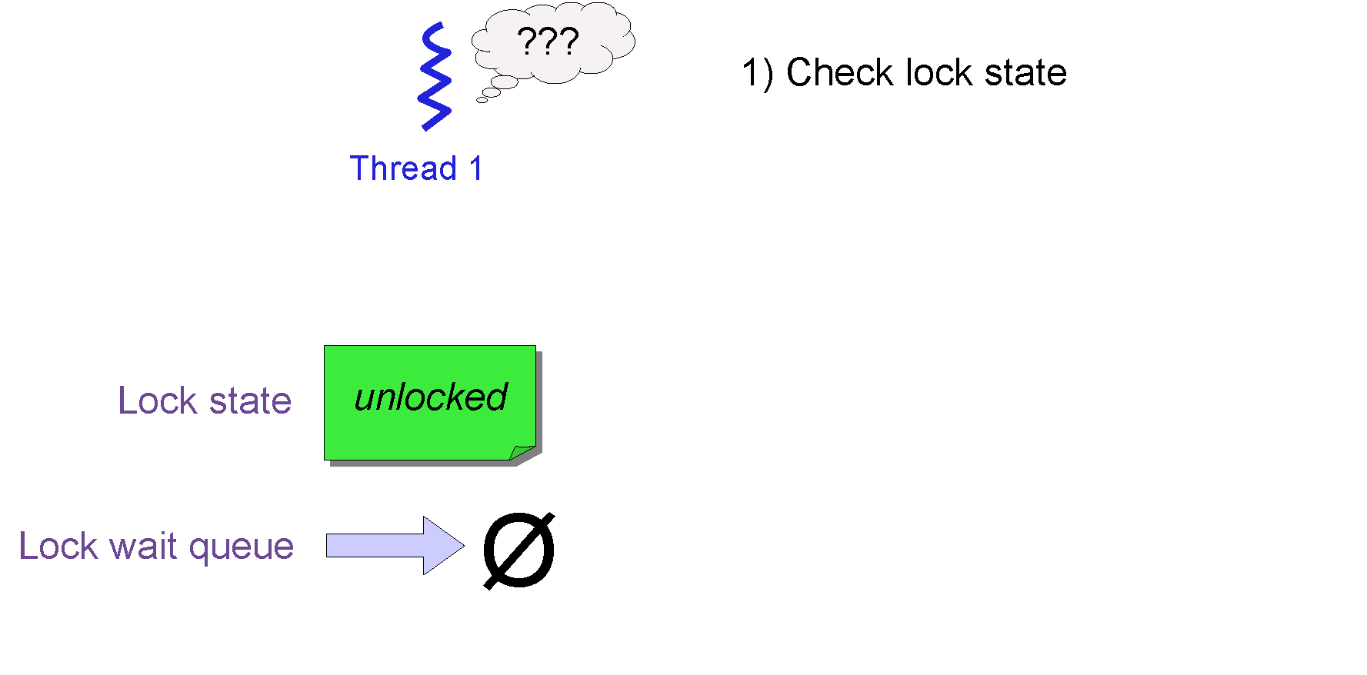
Mutexes – Blocking Locks
Really want a thread waiting to enter a critical section to block
Put the thread to sleep until it can enter the critical section
Frees up the CPU for other threads to run
Straightforward to implement using our TCB queues!

Slide 3
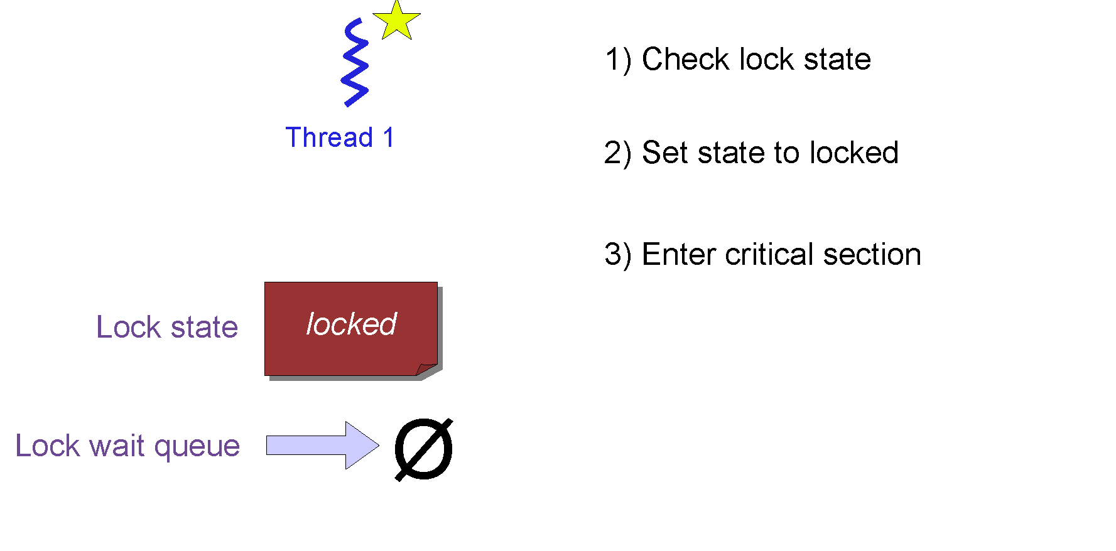
Mutexes – Blocking Locks
Really want a thread waiting to enter a critical section to block
Put the thread to sleep until it can enter the critical section
Frees up the CPU for other threads to run
Straightforward to implement using our TCB queues!

Slide 4

Mutexes – Blocking Locks
Really want a thread waiting to enter a critical section to block
Put the thread to sleep until it can enter the critical section
Frees up the CPU for other threads to run
Straightforward to implement using our TCB queues!

Slide 5
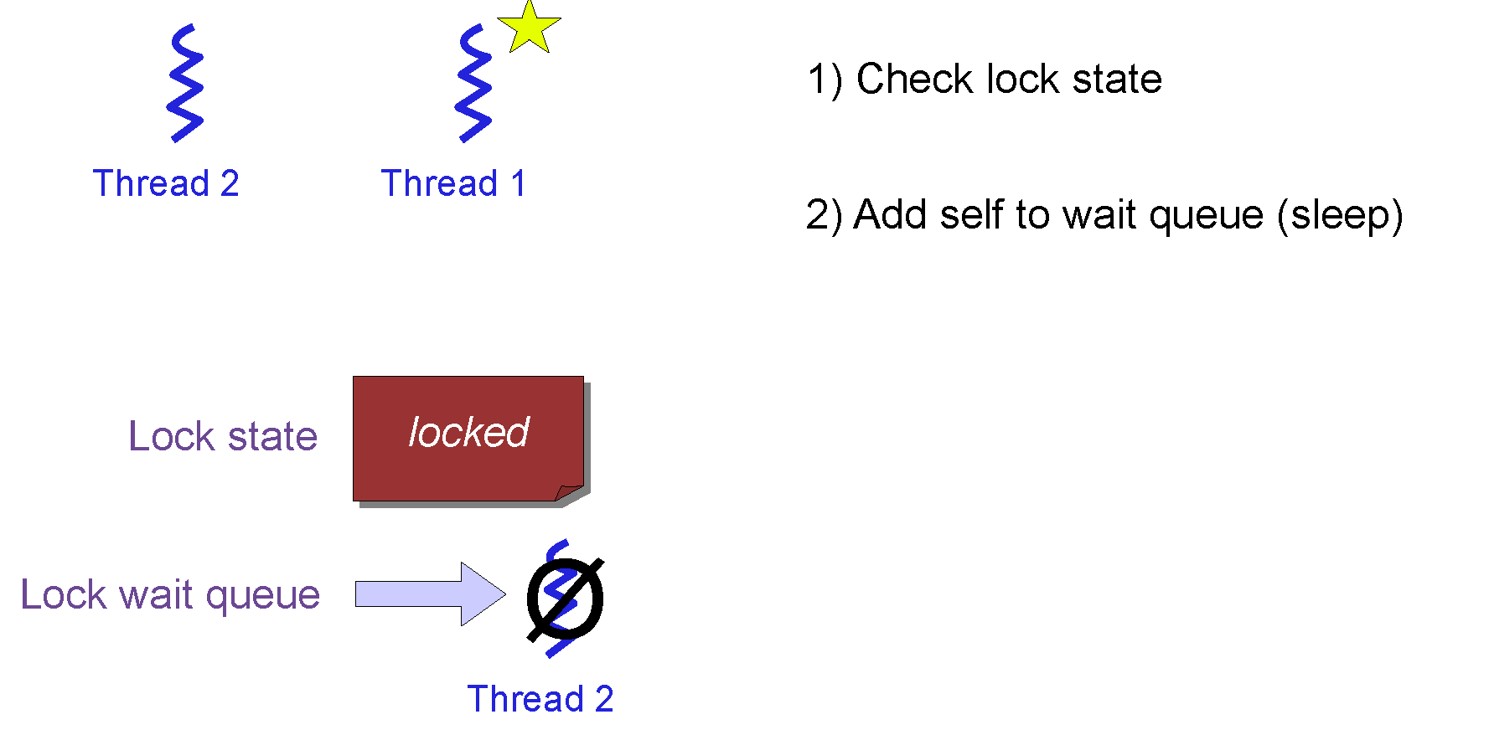
Mutexes – Blocking Locks
Really want a thread waiting to enter a critical section to block
Put the thread to sleep until it can enter the critical section
Frees up the CPU for other threads to run
Straightforward to implement using our TCB queues!

Slide 6
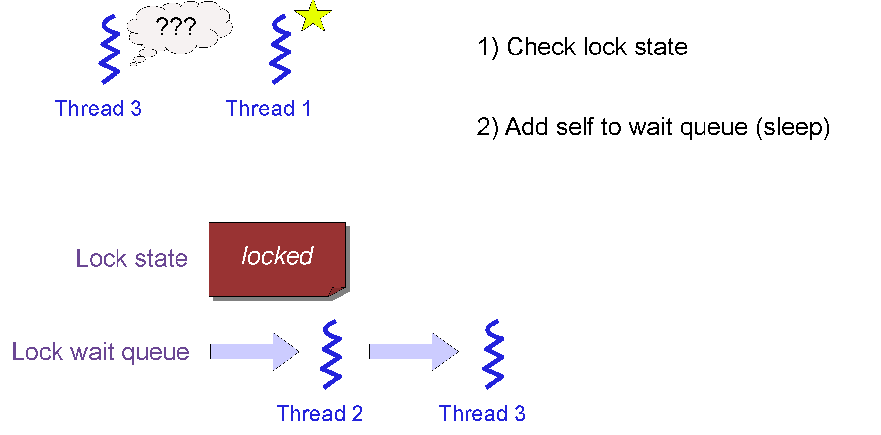
Mutexes – Blocking Locks
Really want a thread waiting to enter a critical section to block
Put the thread to sleep until it can enter the critical section
Frees up the CPU for other threads to run
Straightforward to implement using our TCB queues!

Slide 7
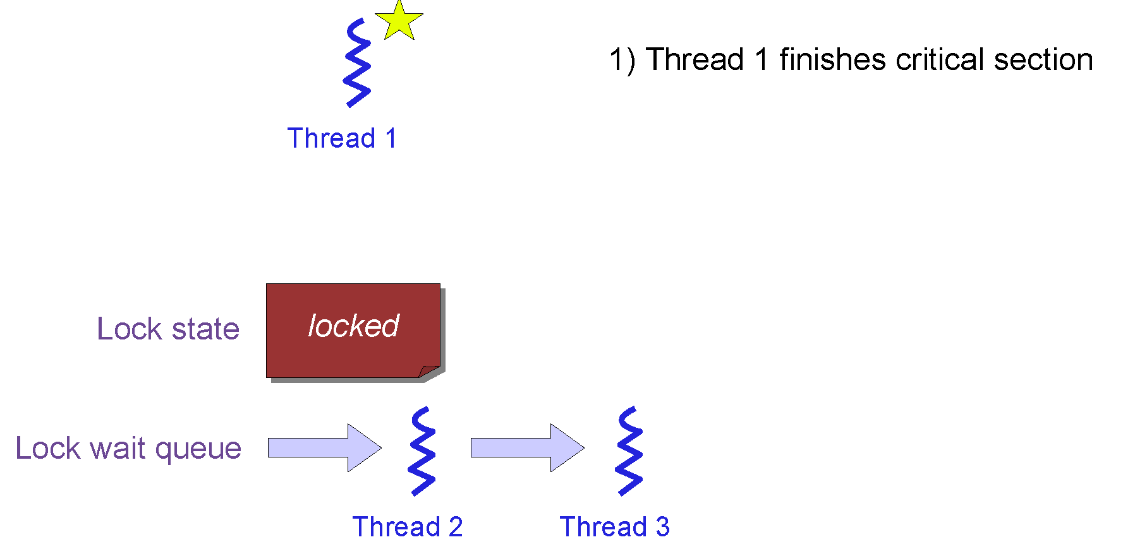
Mutexes – Blocking Locks
Really want a thread waiting to enter a critical section to block
Put the thread to sleep until it can enter the critical section
Frees up the CPU for other threads to run
Straightforward to implement using our TCB queues!

Slide 8
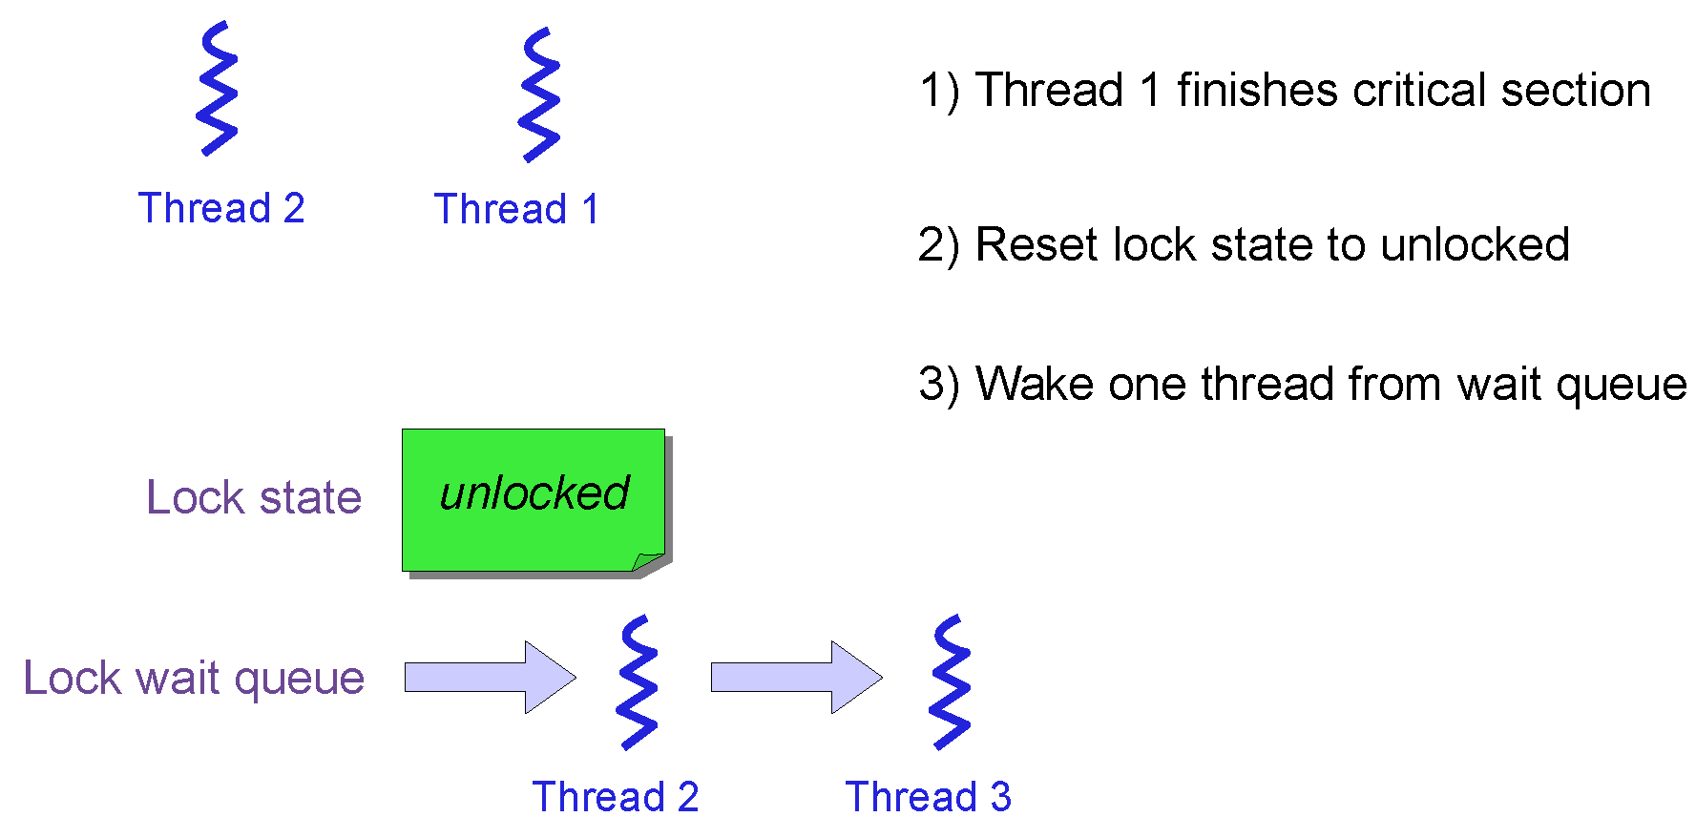
Mutexes – Blocking Locks
Really want a thread waiting to enter a critical section to block
Put the thread to sleep until it can enter the critical section
Frees up the CPU for other threads to run
Straightforward to implement using our TCB queues!

Slide 9
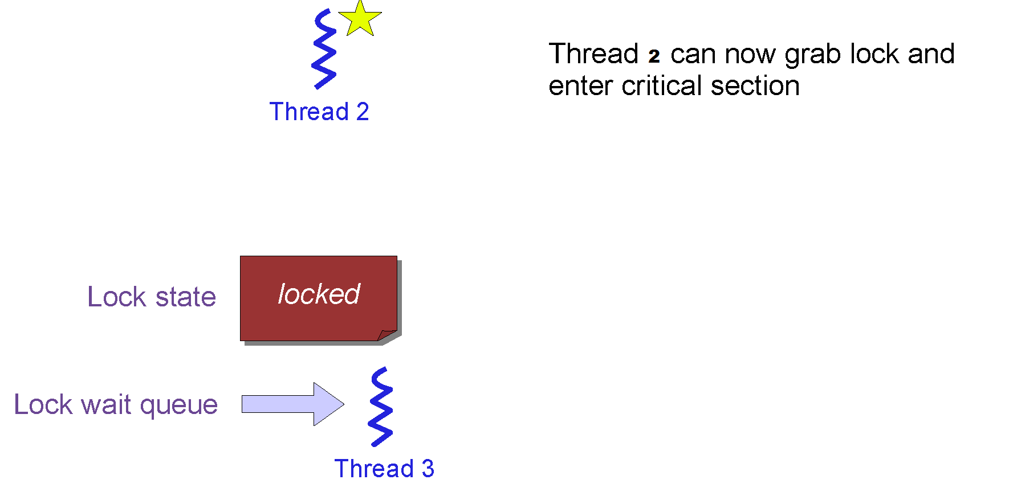
Mutexes – Blocking Locks
Really want a thread waiting to enter a critical section to block
Put the thread to sleep until it can enter the critical section
Frees up the CPU for other threads to run
Straightforward to implement using our TCB queues!

Slide 10
Limitations of locks
Locks are useful for many things, but sometimes programs have different requirements.
Examples?
Say we had a shared variable where we wanted any number of threads to read the variable, but only one thread to write it.
How would you do this with locks?
What's wrong with this code?
Reader() { lock.acquire(); mycopy = shared_var; lock.release(); return mycopy; } | Writer() { lock.acquire(); shared_var = NEW_VALUE; lock.release(); }

Slide 11
Limitations of locks
Locks ensures mutual exclusion, but no execution order.
We usually want to say this should happen before this.
E.g Audio-Video player: network and display threads; shared buffer
What if you want to protect access to two (or more) data structures at a time?
e.g., Transferring money from one bank account to another.
Simple approach: Use a separate lock for each.
What happens if you have transfer from account A -> account B, at the same times transfer from account B -> account A?
We will get into this next time.

Slide 12
Semaphores
Semaphores are a kind of generalized locks
First defined by Dijkstra in late 60s
Semaphores are data structures that provide synchronization. They include:
An non-negative integer variable count accessed only through 2 atomic operations
wait (also called P, downr) - block until semaphore is free, then decrement the variable
Wait for semaphore value to become > 0, then decrement it
signal (also called V, up) - increment the variable and unblock a waiting thread if there are any
Increments semaphore value by 1.
A queue for waiting threads
Note that P() stands for “proberen” (to test) and V() stands for “verhogen” (to increment) in Dutch

Slide 13
Semaphores Like Integers Except
Semaphores are like integers, except
No negative values
Only operations allowed are P and V – can’t read or write value, except to set it initially
Operations must be atomic
Two P’s together can’t decrement value below zero
Similarly, thread going to sleep in P won’t miss wakeup from V – even if they both happen at same time
Semaphore from railway analogy
Here is a semaphore initialized to 2 for resource control:
Value=2
Value=1
Value=0
Value=1
Value=0
Value=2

Slide 14
Semaphore Implementation
struct semaphore {
int val;
thread_list waiting; // List of threads waiting for semaphore
};
P(semaphore *S){
while (S->value <= 0){ //why not if
add this process to S-> waiting;
block(this thread);
}
S->value--;
}
Must be atomic
V(semaphore *S){
S->value++;
if (s→waiting is not empty){
remove a process P from S->list;
wakeup(P);
}
}
Must be atomic

Slide 15
Semaphore Implementation
How do we ensure that the semaphore implementation is atomic?
Approach 1: Make them system calls, and ensure only one P()r V() operation can be executed by any process at a time.
This effectively puts a lock around the P() and V() operations themselves! Since system calls cannot be interrupted.
Easy to do by disabling interrupts in the P() and V() calls.
Not a huge task too. On Intel processors it can be done by cli and sti instructions.
Approach 2: Use hardware support
Say your CPU had atomic P and V instructions
That would have been sweet.

Slide 16
Semaphore Usage 1
Mutual Exclusion (initial value = 1)
Also called “Binary Semaphore”.
Can be used for mutual exclusion:
Semaphores can be used to implement locks:
Semaphore my_semaphore = 1; // Initialize to nonzero
int withdraw(account, amount) {
P(my_semaphore);
balance = get_balance(account); Critical Region
balance -= amount;
put_balance(account, balance);
V(my_semaphore);
return balance;
}

Slide 17
Execution with Semaphores
What happens when the blue thread tries to acquire the lock?
Since lock is acquired by another thread it waits.
P(my_semaphore); balance = get_balance(account); balance -= amount; balance= $1400
Thread 1 runs
Context Switch
Thread 2 runs
P(my_semaphore);
Context Switch
put_balance(account, balance); V(my_semaphore);
Thread 1 Completes
Context Switch
balance = get_balance(account); balance -= amount; put_balance(account, balance); V(my_semaphore);
Thread 1 Completes

Slide 18
Administrivia
Reading
Required: Siberscatz, Operating system concepts, 9th Ed, 5.5, 5.6, 5.7.1
Next class
More sync: condition variables and monitors

